Slide 1
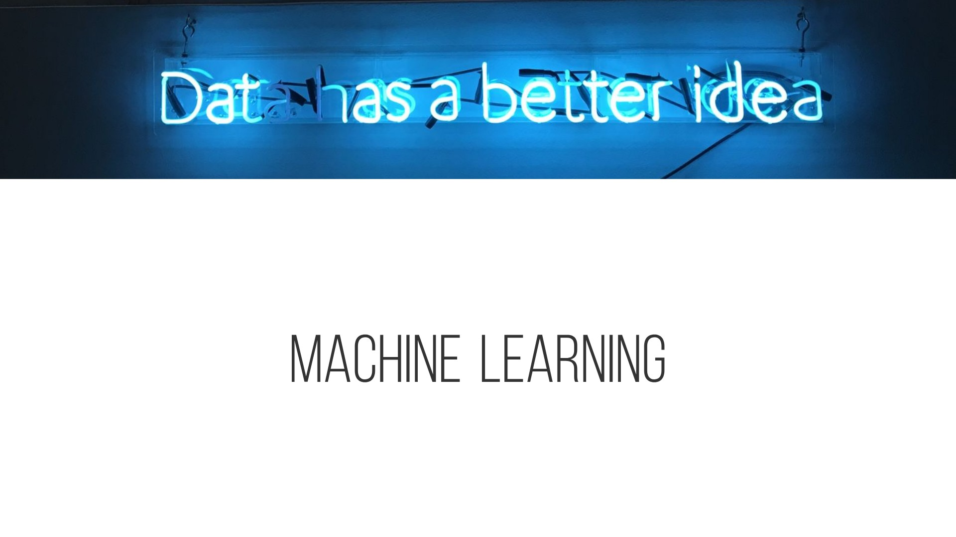

Machine Learning in SFA
Notes:
Thanks for joining us today. First let me tell u what we are not going to talk about today. We are not going to talk about the difference between machine learning and artificial intelligence today. It is a hard question but not really important. The topic we are going to talk about is one of the most asked question in machine learning. How can I use machine learning to solve real world problems?

Slide 2
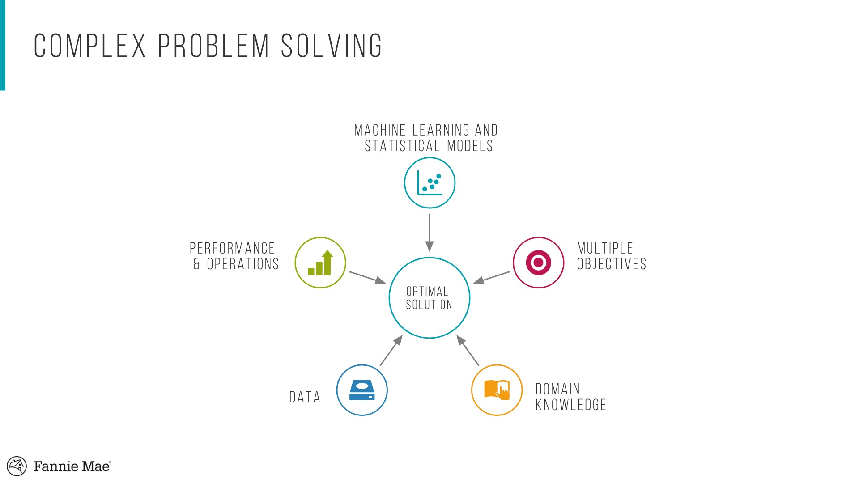
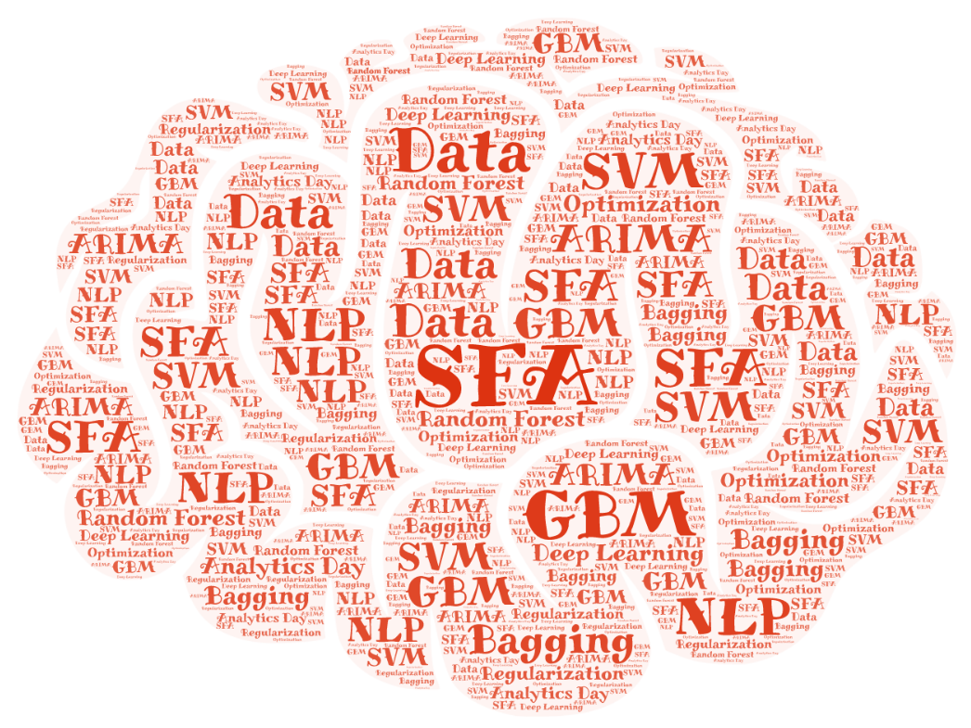


Notes:
Before you learn anything about machine learning, your mind is blank. Then gradually after you learned more and more about machine learning, your mind is filled with machine learning algorithms and techniques. However, some things start to bother you. When faced with a new machine learning problem, which machine learning algorithm should I use? Which metric should I use to measure the model performance? There are no perfect answer to these questions. Here we provide a new way of thinking. Instead of making tough choices, how about… (play sound)

Slide 3
Data limitation encourages more active usage of existing domain knowledge and selecting hybrid solutions
Notes:
That’s right. Instead of trying to find one ultimate solution, we can find hybrid solutions. These five circles represents five important aspects of solving complex problems. First, of course data is extremely important. It is the origin of everything. Then the domain knowledge plays a key role on building a successful model. It helps data scientist to create relevant features and choose adequate objectives. Moreover, the domain knowledge brings constrains to the problem that makes sure the final model works as expected in production environment. Objectives are also crucial. In reality single objective is usually not enough. A simple example is the efficient frontier in portfolio management. There is a tradeoff between return and risk. Based on the current market condition and risk appetite, investors can adjust the weights between two objectives. Similarly, in Fannie many problems also need multiple objectives. For example, controlling credit risk is one objective, providing more affordable housing is another objective. With multi objective optimization, the solution can meet different business needs. Finally, let’s talk about the machine learning and statistical models. One most frequently question asked in StackOverflow and Quora is that which machine learning algorithm should I use for a specific problem. However, the optimal solution is sometimes not based on one single machine learning algorithm.

Slide 4
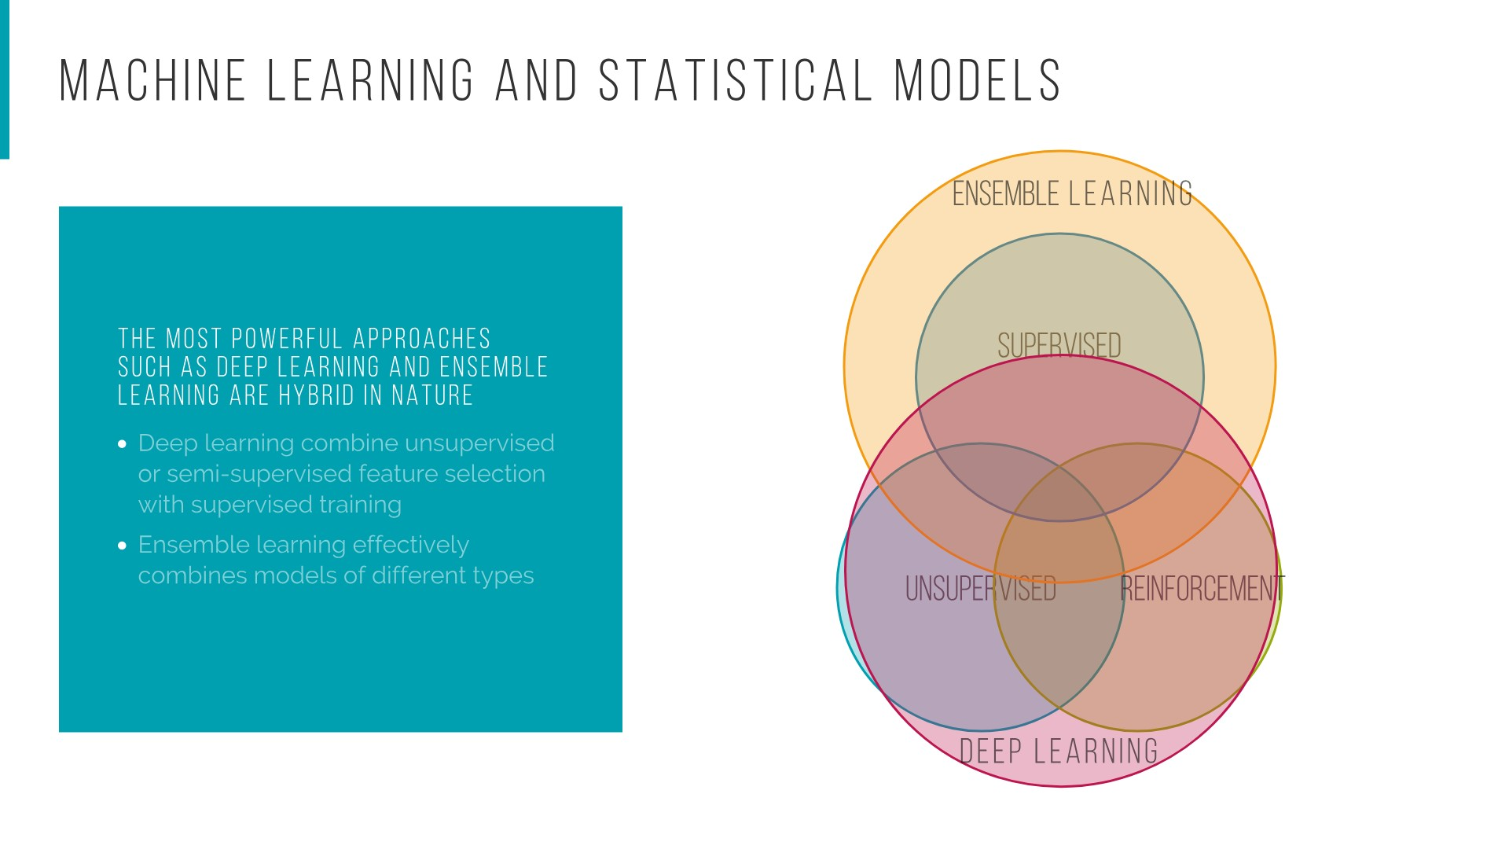
Notes:
Instead, the optimal algorithm is usually a hybrid model. Here at the bottom we have three circles. The supervised learning, unsupervised learning and reinforcement learning. With machine learning approaches like ensemble learning or deep learning, we can create a more powerful hybrid model. For example, when we build a deep learning model, we can use unsupervised algorithms like autoencoder to extract features and then connect to a supervised algorithm like multi layer perceptron network to do classification.

Slide 5
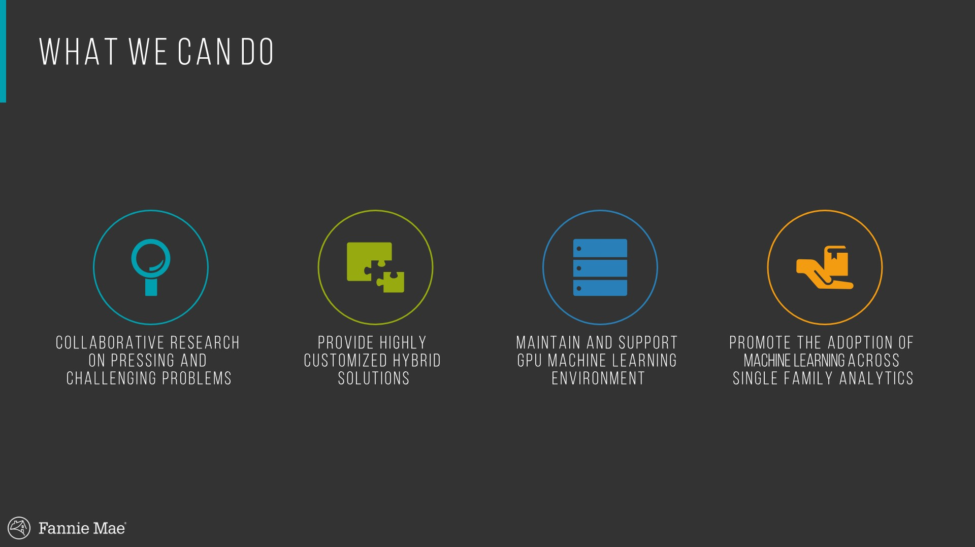
Notes:
One more thing before I give the time to Merritt and Rebecca to show you some real word use cases of hybrid models. As a team, we have learnt a lot on how to use hybrid models to solve real world problems. And we are very interested in collaborating with other teams in SFA to apply hybrid methods to other challenging problems. Even for existing models, the adoption of a hybrid method like ensembling can potentially make the existing model more stable and more resistant to region change. Besides, thanks to Steve and Divas we currently have a very powerful GPU machine learning environment. Anyone who is interested in trying deep learning or machine learning please let me know I can set up an account for you. Finally, we will continuously promote the adoption of machine learning across SFA. If anyone has any good idea, please let us know and we can try to make it happen. Now let me give the time to Merritt and Rebecca.

Slide 6
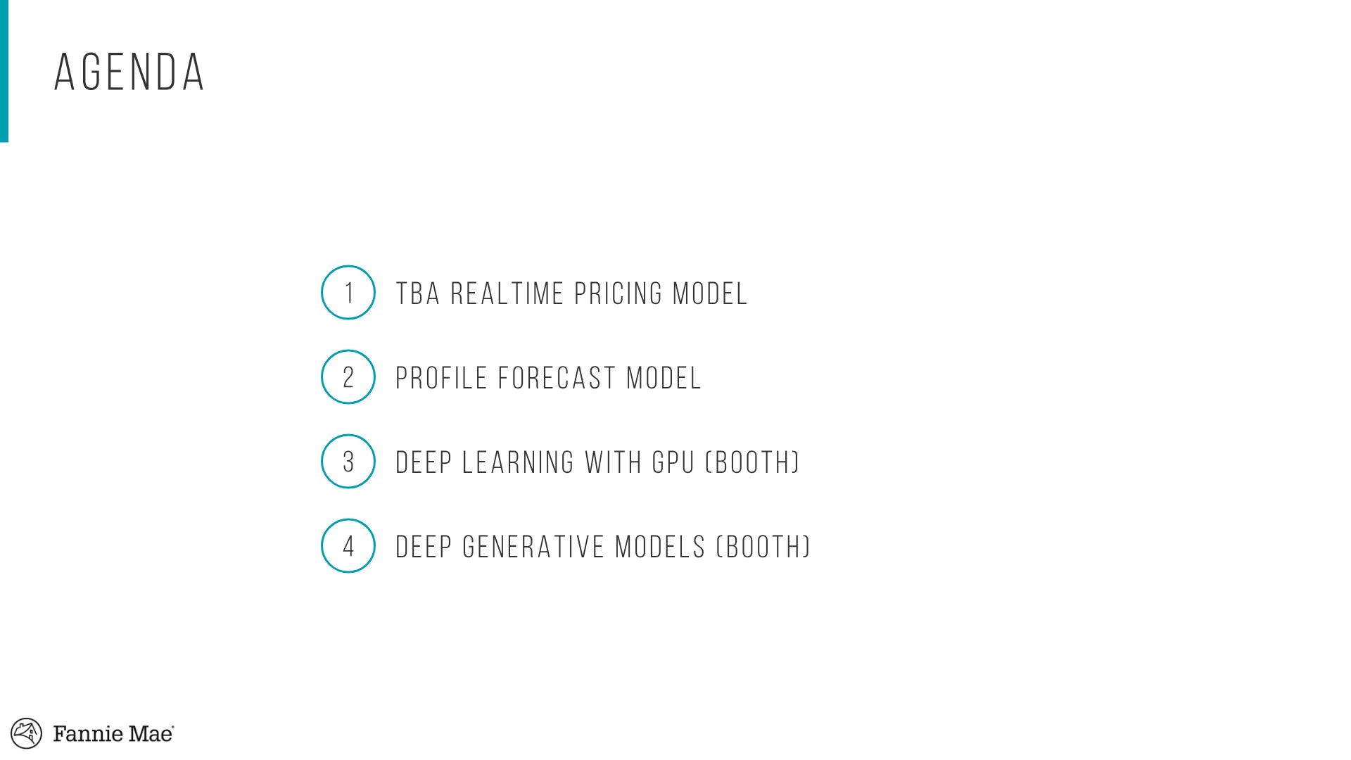

Slide 7
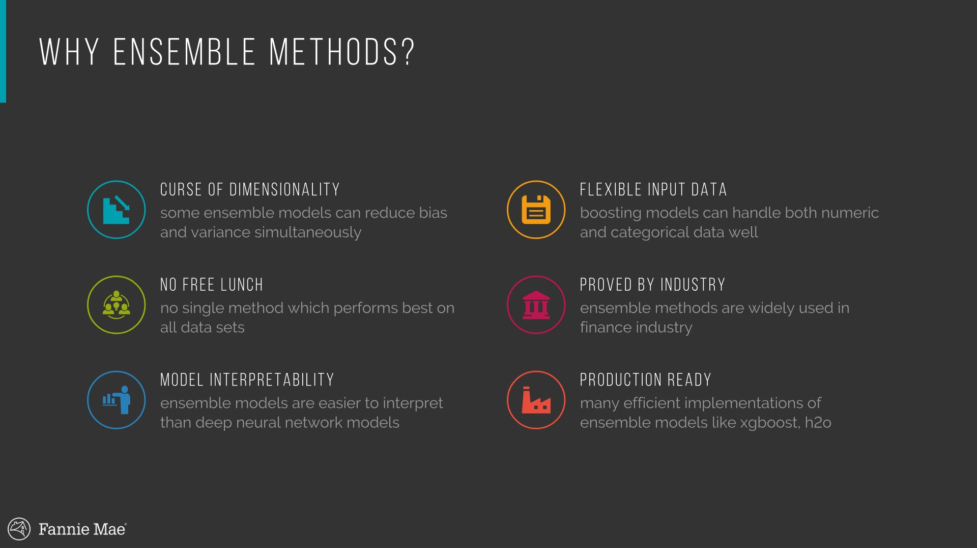

Slide 8
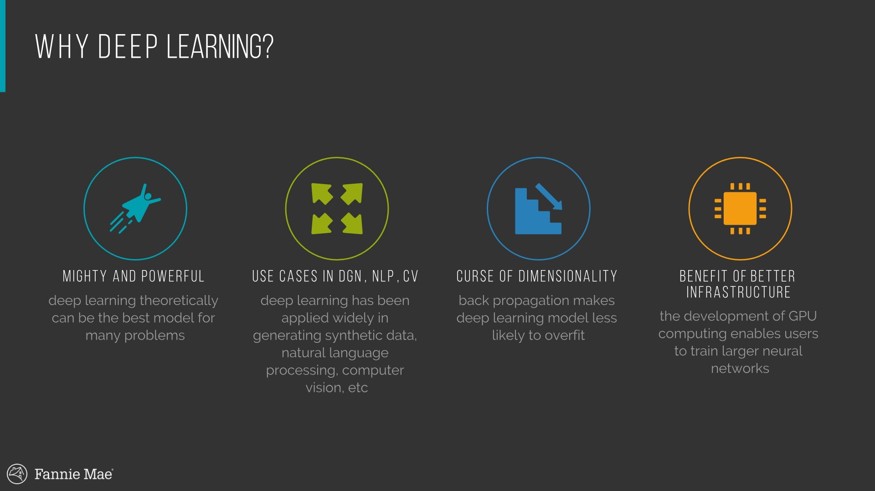

Slide 9
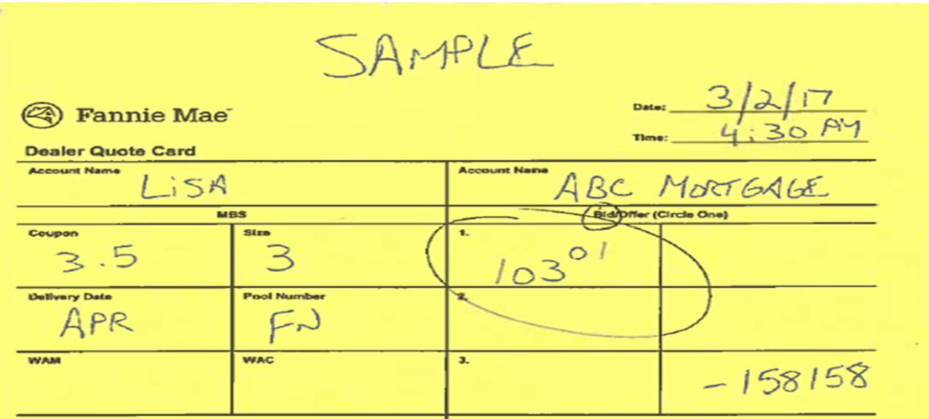
MBS Trading Model
5/21/2019

Slide 10
Acknowledgements
Thanks to Lisa Mitiguy and the MBS Trade Initiative Group

Slide 11
Outline
1. Business Problem
MBS Trade Automation
MBS Trading Platform
Modeling Problem
General Model Design
State Space Models
Implementation Details
Preliminary Results
4. Next Steps + Extensions

Slide 12
Business Problem
Build an automated MBS trading platform to provide lenders the ability to electronically trade TBAs and Specified pools with Fannie Mae.
In 2016
- Fannie Mae manually keyed over 81,000 MBS trades with 369 lenders ($467 billion UPB)
- Duplications, omissions, and input errors result in ~50 misbooked trades per month
- Lack of online presence is a missed opportunity to bid on MBS trades
TBA trading is operationally inefficient for both Fannie Mae and our lender customers. This puts Fannie Mae at a competitive disadvantage with certain lenders.
The Automated TBA Trading Platform will:
- Enhance execution options for the lenders such as forward Spec trading, bidding out of competition, and non-standard settlement.
Improve our efficiency, competitiveness and customer service
Reduces our compliance exposure

Slide 13
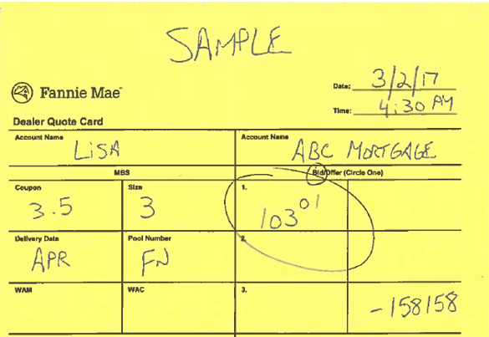

Current TBA Process
The current state TBA trade process has numerous opportunities for human error.
Account Exec calls Trader for bid quote
Lender decisions and asks to accept the trade based on the quoted price
FNM back office manually confirms the trade with lender via email or phone
Account Exec takes order
Trader generates the bid quote
Account Exec gives bid quote to lender
Account Exec relays desire to accept the bid to the Trader
The lender enters the trade into their native application
The lender calls Sales desk for bid quote
Trader relays bid quote to Account Exec
Multiple back and forth with lenders when trade errors are discovered
FNM Trader calls transaction done.
AE reads back trade to lender.
AE enters ticket into Aladdin.
Customer pain
Fannie Mae pain
Requires a phone call to transact
Multiple manual steps (e.g. trade entry, confirmations, reconciliations)
Risk of trade errors
Cost/time spent on trade reconciliation
No system-to-system integration
No real-time visibility into trades
No ability to self-serve (e.g. assignments, modifications, allocations)
Trading volumes go to competitors
Requires a phone call to transact (6,000 trades/mo)
Multiple manual steps (e.g. trade entry, confirmations, reconciliations)
Risk of trade errors
Cost/time spent on trade reconciliation
No system-to-system integration
Heavy use of Account exec and Trader time on bid quotes, trade execution, and trade entry
Competitive disadvantage / lost revenue opportunity

Slide 14
Target TBA Process
An automated trading platform streamlines the TBA trading process.
A price quote is automatically generated and displayed to the lender
Trade is executed, recorded, and confirmed real-time in both the Fannie Mae and lender systems via direct integration
Lender submits bid request online
The lender decisions and accepts the trade online
Online bid request, bid quote, bid acceptance, and trade confirmations
Accepted trades entered automatically into customer and Fannie Mae systems
Real-time visibility into trades and trade positions
Self-serve capabilities (e.g. assignments, modifications, allocations)
Account Executive and Trader time dedicated to account analysis and strategy

Slide 15
MBS Trade Platform
The MBS Trading Platform simplifies the lender’s process, improves trade accuracy, and provides greater trade certainty.
SIMPLIFY
the customer experience
CERTAINTY
of sale, execution and process
CERTAINTY
of sale, execution,
and process
BUILD
unrivaled customer relationships
DEVELOP
an effective, adaptive organization
Enable faster trading
Eliminate phone calls and wait time
Improve trade accuracy
Enable visibility into trade details
Reduce errors and reconciliation
Save time in performing trade modifications and assignments
Enable same-day Early Funding by speeding trade assignments
Provide self-service
Immediate confirmation of trade details
Online view of trade history
Online view of open trade positions
Online view of trade assignment details
Improve view into trading wins / losses (FNM)
Ability to deliver WL against TBA trades improving lenders Best Ex by ~3bps
Eliminate trade discrepancy and resolution activities reducing/ eliminating Operational Incidents
Improve trading opportunity resulting in $45 MM over 5 yrs
Allow Account Execs and Traders to focus on the strategic needs of the lender
Free up Account Execs to better serve the CDTs
Bring Fannie Mae up to par and perhaps surpass industry standards
Enable other strategic offerings (e.g. forward Spec Pool trading, bid out of competition, non-standard settlement)

Slide 16
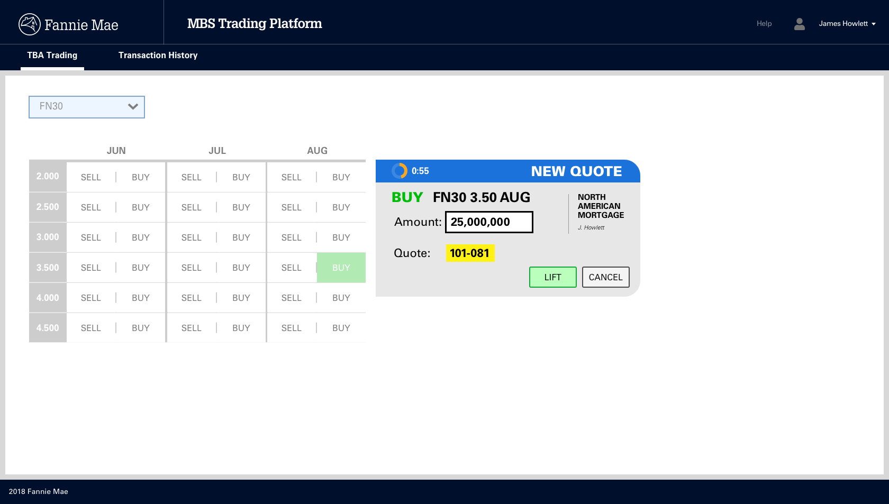

Slide 17
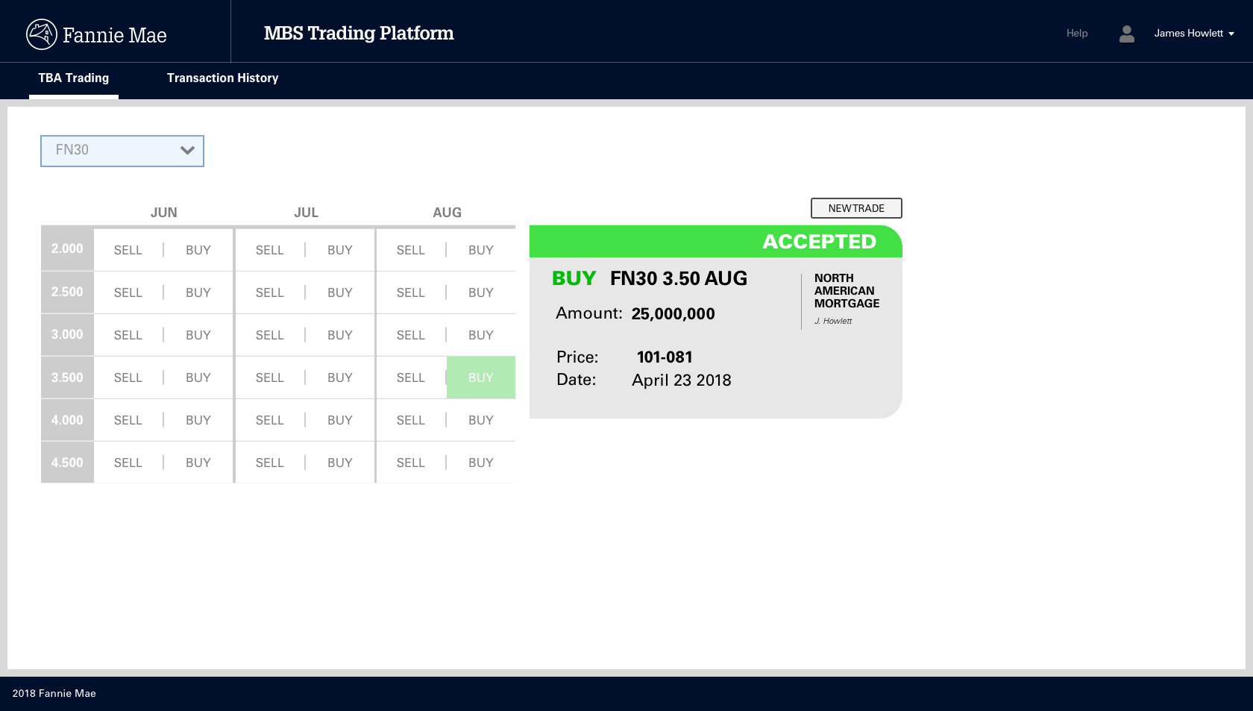

Slide 18
Preliminary Feedback
The Automated MBS trading platform simplifies the process of trading with Fannie Mae
Strong Customer Response:
One particular lender dislikes transacting over the phone. Since beginning to use the platform the same lender showed 72 trades ($1.97b) and Fannie won ~$600 million of business.
One trader now includes Fannie Mae in the trade inquiry/bid process 100% of the time since accessing our online trading platform—up from ~50% before.

Slide 19
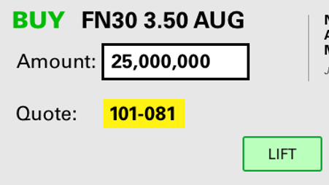
Modeling Problem
Produce real-time indicative TBA prices for the MBS Trading Platform
Generate streaming estimated prices for the Automated Trading Tool—a live quote
An ideal solution will have good performance and be stable, extensible, and function well in a real-time environment
Stability indicates the need for a model with strong performance across different market regimes
Extensible means the ability incorporate machine learning extensions (ensembles, RNNs)
Due to the real-time nature of the problem the solution should be computationally feasible

Slide 20
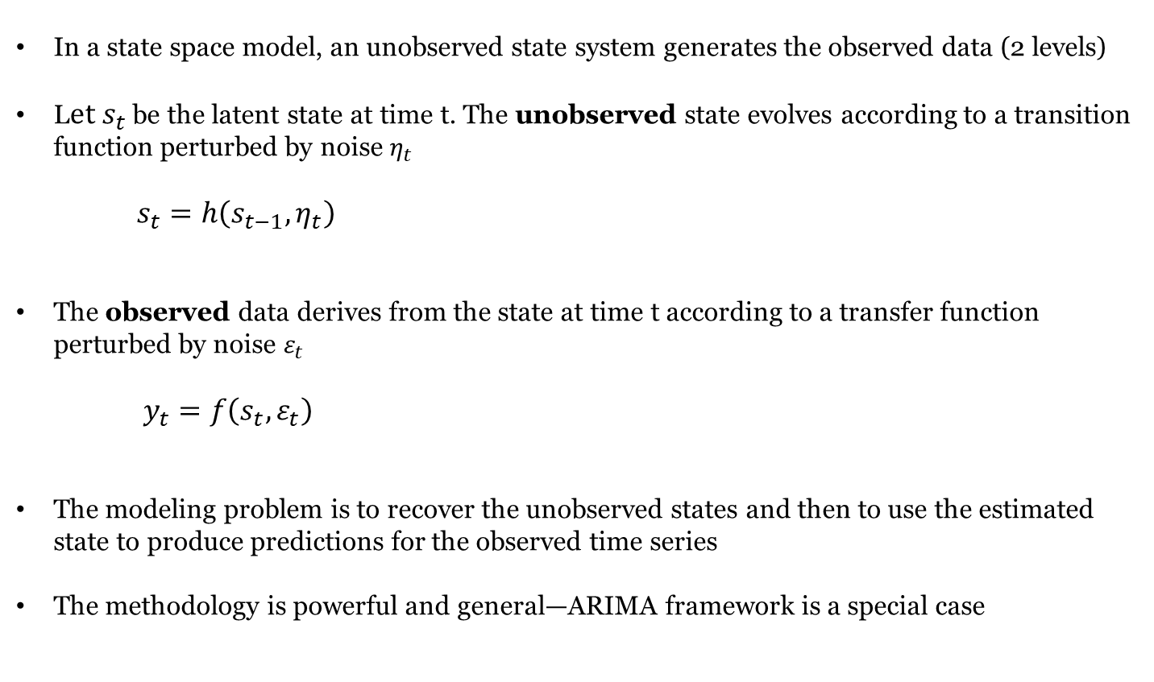
General Methodology
The MBS Trading Model uses a State Space Methodology
In a state space model, an unobserved state system generates the observed data (2 levels)
L$et s_{t}$ be the latent state at time t. The unobserved state evolves according to a transition function perturbed by noise $η_{t}$
$s_{t}=h\left(s_{t−1},η_{t}\right)$
The observed data derives from the state at time t according to a transfer function perturbed by noise $ε_{t}$
$y_{t}=f\left(s_{t},ε_{t}\right)$
The modeling problem is to recover the unobserved states and then to use the estimated state to produce predictions for the observed time series
The methodology is powerful and general—ARIMA framework is a special case

Slide 21
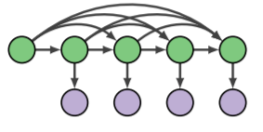
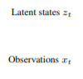
State Space Transition
In our application we will assume a Markovian structure but more general State Space models can have long run dependence
The State Space formulation naturally handles missing data and regime shifts
Model fitting is done by a prediction, error correction feedback loop

Slide 22
Model Details: Input Data
Bivariate Dependent Variables:
- Tradeweb FNCL TBA Price Quote Series -millisecond frequency
- Bloomberg FNCL TBA Price Quote Series -second frequency
Independent Variables:
- IRDB OTR 2/5/10 TSY Yield Series -millisecond stream
- Bloomberg VIX + SP500 -second stream
Notice we have multiple observation series for the same FNCL Price Quotes.
Each price source can be viewed as a “perturbed” version of the true signal we’re trying to recover

Slide 23
Model Details: DLM
The MBS Trading Model implements a Dynamic Linear Model (DLM)
In our problem we have a bivariate Observation Series (TW + BB prices)
The unobserved states are the relationship (weights/Betas) between TBA yields and the real-time Treasury Curve
The MBS Trading Model will recover the unobserved states periodically (~ every 30s)
Filtering done using the well-known Kalman filter
Prediction/feedback loop
Once states are predicted we can make real-time quotes. Real-time price streams interact with the regression betas to general real-time price estimates within the JAVA application

Slide 24
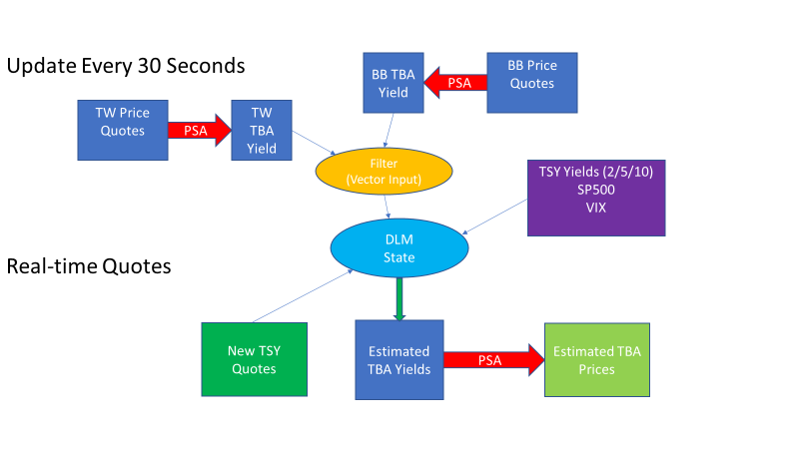
Modeling Flow

Slide 25
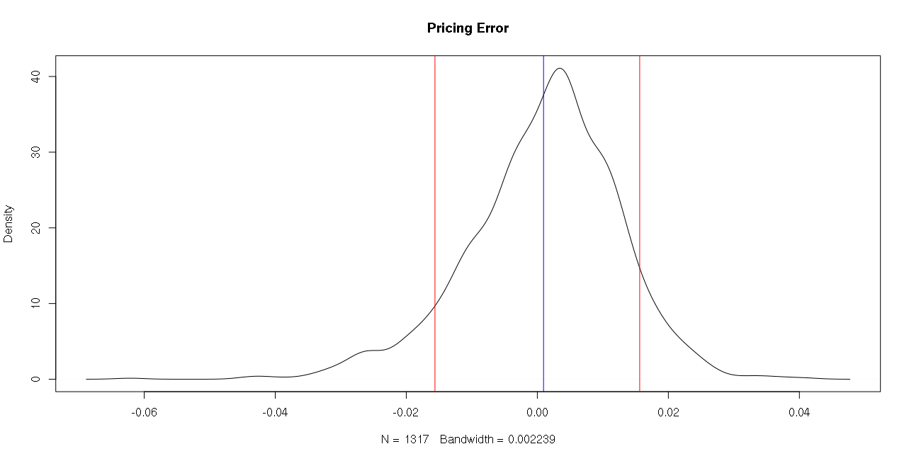
Preliminary Results
Pricing Error
Error Coverage
Pricing Error (Tick)

Slide 26
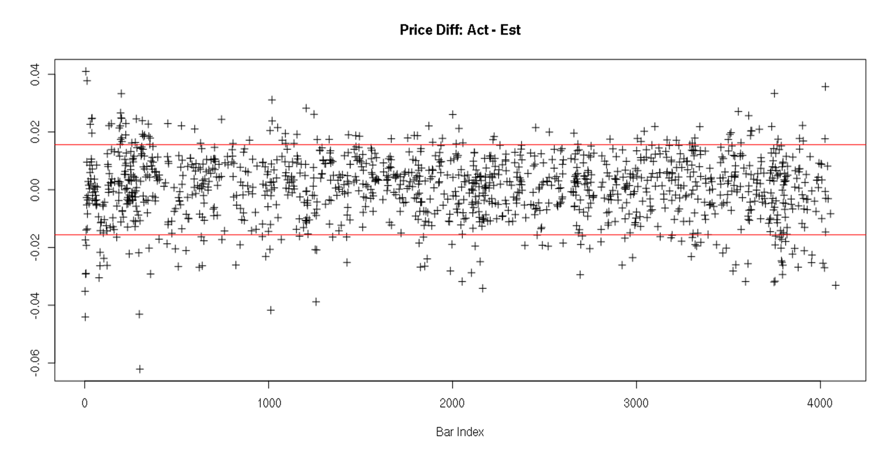
Preliminary Results 2

Slide 27
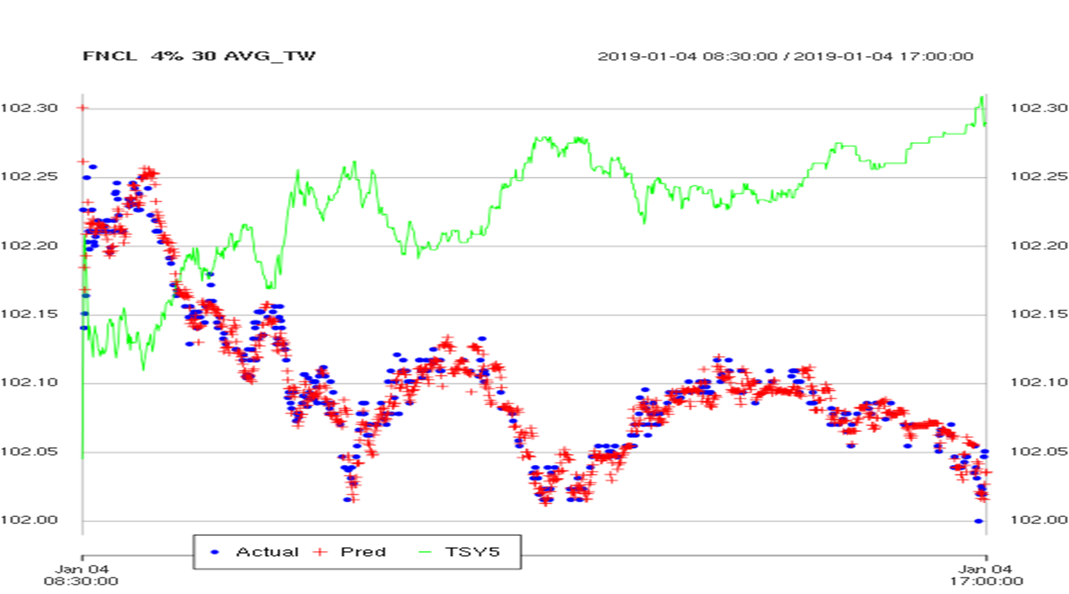
Preliminary Results 3

Slide 28
Next Steps
Incremental walk-forward testing and model extensions
As new market data arrives continue walk-forward testing out of sample
- Particular attention to performance stability over different market regimes
The model is simultaneously being tested for integration into the Trading platform
R code called periodically by JAVA application
Real-time predictions produced by JAVA application
Develop and integrate potential extensions
Comparison to baseline models
Monitoring model stability

Slide 29
Extensions
State Space Methods accommodate diverse ML extensions
Preliminary testing indicates that the model performance meets user requirements
However, the model potentially can be improved by considering extensions:
1. Ensemble models generate better predictions using a diverse set of individual models
2. The State Space framework fits naturally into RNN
LSTM (Long Short-term Memory)
GRU (Gated Recurrent Units)
There are exciting new developments that meld State Space models and Machine Learning
- State Space LSTM Models with Particle MCMC Inference (Zheng, et al. 2017)

Slide 30
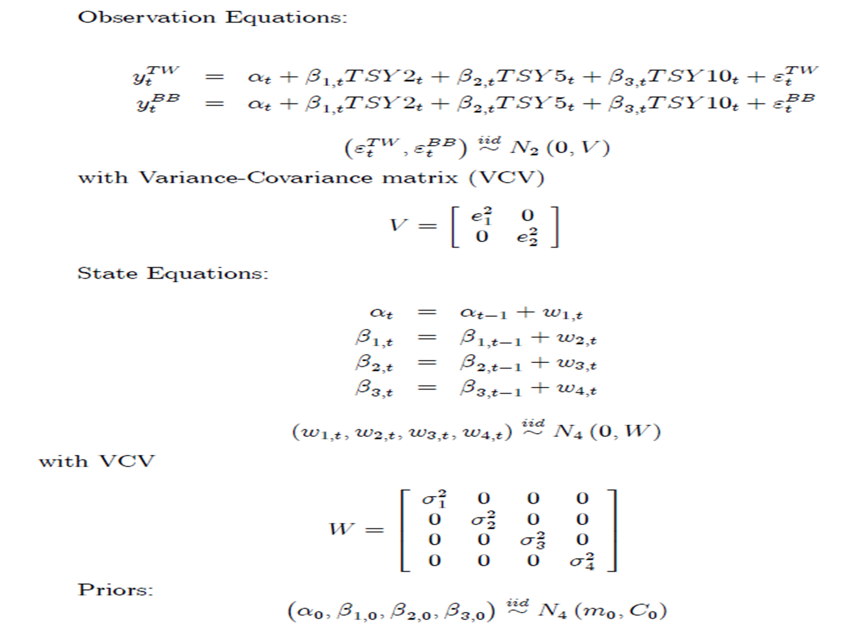
Appendix
Yields series are modeled using Dynamic Linear Models (DLM)

Slide 31
Profile Forecast
SFA Analytics Day
Notes:
Next, I am going to talk about another project our group is working on .“Profile Forecast”

Slide 32
Why do we need profile forecast?
Risk Control
ERM uses Profile Forecast for their 90-day outlook which tracks potential limits breaches
Indicator of Policy Change
ESR uses Profile Forecast as a way to understand the implications of policy changes
Housing Goals
Profile Forecast will inform the future view of Housing Goals
Lender Service
Credit Risk Transfer
Profile Forecast could capture the moving trend of loans characteristics from lender/servicer perspective. We could provide guideline to prevent some borrowers’ risky behaviors.
Profile Forecast will help prepare upcoming CRT deals through both sizing and pricing procedures.
Notes:
The first question is always
“Why do we need profile forecast? “
Different departments and individuals use the forecast statistics for their own purposes.
(ppt parts)
Therefore, accurate Profile forecast is very important to our business.

Slide 33
Background: ESR Profile Forecast
Short-Term Monthly Predictions
Weighted Average Loan Attributes
% of Target Population
Model Calculated Fields
% of Scorable Housing Goals
WA FICO
WA LTV
% LTV >80
% LTV >90
% LTV >97
Capital
ROC
ACIp
% of Low-Income PMM Goal
% of Very Low-Income PMM Goal
Notes:
Currently, ESR has its own system to produce monthly production reports of short-term profile forecast The reports have projections of several components. Those include WA LOAN Attributes, % of target population, model calculated fields, and % of scorable housing goals

Slide 34
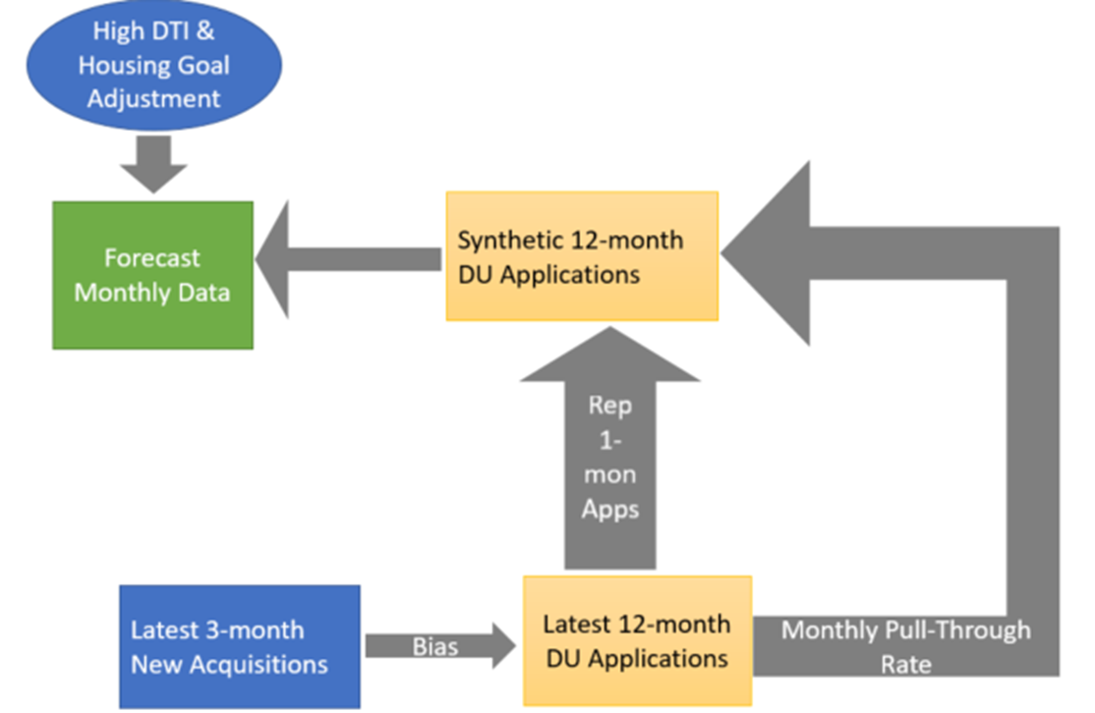
Current Production Model
Potential Risks in the Current Procedures
Monthly pattern may be lost.
The loan-level adjustment might not work for vintage DU Apps.
The error is getting larger for longer duration.
High DTI & Housing Goal Adjustments over adjust.
Notes:
But Why not use the current model? Why is necessary for us to explore new approaches?
On the left side, it’s a workflow of the current profile forecast model. We can tell a couple potentials risks exist here.
First of all, Monthly pattern may be lost, when the loan-level adjustments have been calculated by averaging 3-month differences between acquired DU Applications and total Acquisitions.
Second, The loan-level adjustments calculated by latest 3-month acquisitions but applied to the latest 12-month DU Applications will bring over or under adjustments for the vintage DU Apps.
3. Third, Synthetic DU Apps have been created by copying the last-month DU Apps multiple times. Therefore, the error is getting larger for longer-term predictions.
4. In addition, High DTI adjustment and Housing Goal Adjustments will over-adjust results.

Slide 35
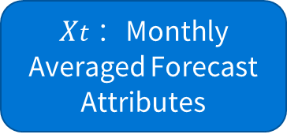
Enhanced Model: Diagram of the Hybrid System
Minimum Spinning Tree Clustering: (Graph-Based Clustering)
Warranties global optimal solutions
Can Work with different distance metrics
Ensemble Model:
Equal-weight aggregation of multiple learning algorithms to obtain better predictions
Equal weight 1/n
Base Models
Prism Netezza
$Xt$ ：Monthly Averaged Forecast Attributes
Yt : Xt – Xt-k , where k is the predicted duration
Linear Regression Models
Yt ~ Yt-1 + One Econ
Yt ~ Yt-1 + Two Econs
RM1
RM2
RM3
RM4
RM5
…
RMN-1
RMN
FRED
Economic Variables
Based on a Performance Measurement Matrix
Mean Square Errors
Largest Error Terms
Kendall Tau Distances
Ensemble Model
Final Ensemble Model
Equal-Weight Ensemble
Representative Base Models
MST Clustering
Selected Base Models
Notes:
As Zhenyi mentioned, in the reality, we usually need a hybrid system to solve the complicated problem. Here is a flow chart of our proposal. Our target variable can be any monthly weighted average attribute or % of target population.
The first step is the data collection from both PRISM Netezza database and federal reserve economic data website.
From the PRISM Netezza new acquisition table, we could get time-series values for our target variable, for example weighted average LTV for monthly new acquisitions We mark it as Xt. Then, if our model is for k month prediction, the predicted variable we will use in the base models is Yt, It is the difference between X value at time t and X value at time t-k.
After the data preparation, we will set up a pool of simple linear regression models, which we call base models here. In each base model, the target variable is Yt. And the independent variables are Y t-1 and any combination of less than 2 economic variables.
Within all of prepared base models, only the comparable best performance models will be picked. The selection criteria is based on a performance measurement matrix.(Click) In the matrix, both training dataset and validation dataset’s mean squared errors, largest error terms and kendall tau distance (which is a ranking distance) will be applied to select base models.
Once we have a pool of selected base models, we will take care of the possibility that some of them have comparable results. Therefore, we will apply MST clustering and create one representative base model for each cluster. There are couple of reasons why we use minimum spinning tree clustering in this case. (Click)As a graph-based clustering, the clustering provides global optimal solutions and the distance matrix is not limited as euclidean distance. Compared to K-means clustering which most of us are more familiar with, MST clustering can be used to handle the clustering problem with more complex boundaries.
The last step of this system is to ensemble the representative base models. (Click)For our case, the training data and validation data are consistent for each representative base model, and the ensemble weights are exactly the same.

Slide 36
Enhanced Model: Short-Term Performance
Error terms are unbiased and have been significantly reduced from ESR production model errors.
The short-term predicted values follow the moving trend of actual value
Notes:
How does our model perform? Let’s first look at the short-term model performance. We will use the ERS production performance as our benchmark here.
On the left chart, the solid lines represent ESR production model’s one to three month projection errors, for 2018 monthly WA LTV.
The dash lines represent our enhanced model projection errors.
The current production model errors are always positive for any duration projections.
We can tell with the enhanced model, Error terms become unbiased and have been significantly reduced from production errors.
On the right chart, the yellow line represents the actual monthly WA LTV moving trend. And, our enhanced model predictions also successfully follow the moving trend of the actual values.
From both error and ranking perspectives, our enhanced WA LTV model shows better performance.

Slide 37
Enhanced Model: Short-Term Performance
The Enhanced Model’s MSEs are comparable to the production model’s MSEs, but the largest error term has been reduced.
The short-term predicted values follow the moving trend of actual value
Notes:
For the short-term predictions of monthly WA FICO, the enhanced model performance is quite comparable to the production model from MSEs perspective. One of reasons is that the monthly WA_FICO itself does not have much variabilities from time to time for the past few years.
But still, on the left chart, if we look at the red circle, the largest error term for 2018 production predictions is for Jan. The absolute value is around 2.5. With the enhanced model, the error term has been reduced to 1.
On the right chart, even though the moving trend is very smooth, the enhanced model still captures the trend.

Slide 38
Enhanced Model: Long-Term Performance
Both shorter-term and long-term prediction errors are unbiased.
The long-term prediction errors are even smaller than the short-term errors in the production model. (2.66% and 2.53)
Notes:
Another advantage of our enhanced model is that the framework can be used for longer-term predictions. In this case, we extend the prediction from 3 month to 6 month, and even 12 month.
From the predictions for monthly WA FICO and WA LTV, we can tell
Both shorter-term and long-term prediction errors are unbiased.
The longer-term prediction errors are even smaller than the short-term errors in the production model.
For example, the largest error term for WA_LTV is around 1%, which is from our 6-month prediction. But the largest error term is already 2.66% for the production 3-month predictions.
(2.66% and 2.53)

Slide 39
Enhanced Model: Stability of the ensemble models
The model performance is stable when we shrink and extend the training periods from 5 years to 8 years.
If we use 4-year data (2010-2013) which only contains 48 data points in the model training, the long-term prediction for WA_LTV is not desirable and both short-term and long-term predictions for WA_FICO are inaccurate.
Notes:
How about the stability of this enhanced model?
Then we are going to test, if we shrink and extend the training periods from 4yr to 8years.
From both predictions for WA_LTV and WA_FICO, The model performance is stable when our training period is greater than or equal to 5years. It means we have at least 60 monthly data points in the training set.
If we use 4-year data (2010-2013) which only contains 48 data points in the base model trainings, the long-term prediction for WA_LTV is not desirable and both short-term and long-term predictions for WA_FICO are inaccurate.

Slide 40
Enhanced Model: Highlights
Short-term Ensemble Models
Correct bias
Reduce largest error terms
Long-term Ensemble Models
Provide results which do not exist
Capture the actual moving trend
Are built deep out-of-sample (2010-2015)
Will be used for other potential business usages
Notes:
At the end, we want to highlights a few advantages of our enhanced model.
For the short-term ensemble model, when we compare it to the current production model, first, the error terms become unbiased. Also, the enhanced model reduces the largest error term. At the same time, the predicted values follow the moving trend of actual values.
Once we extend the enhanced model for longer-term prediction, it provides results which don’t exist in current reporting. More than that, the model itself is built deep out of sample. We only use 2010-2015 data in our training process, but the prediction on 2018 acquisitions still looks good. This longer-term prediction definitely will be beneficial for other potential business usages.

Slide 41
Additional Developments:
Implementing generic framework for both short-term and long-term predictions
Applying the generic framework for the scenario analysis
Using multi-objective optimization to select the most predictable N-dimensional buckets in loan attributes
Generating synthetic loans for under-represented sub-populations using deep generative models
Notes:
More than what we have discussed today, there are some additional developments we are working on for the profile forecast.
….

Slide 42
Questions?

Slide 43
Appendix 1

